Slide 1

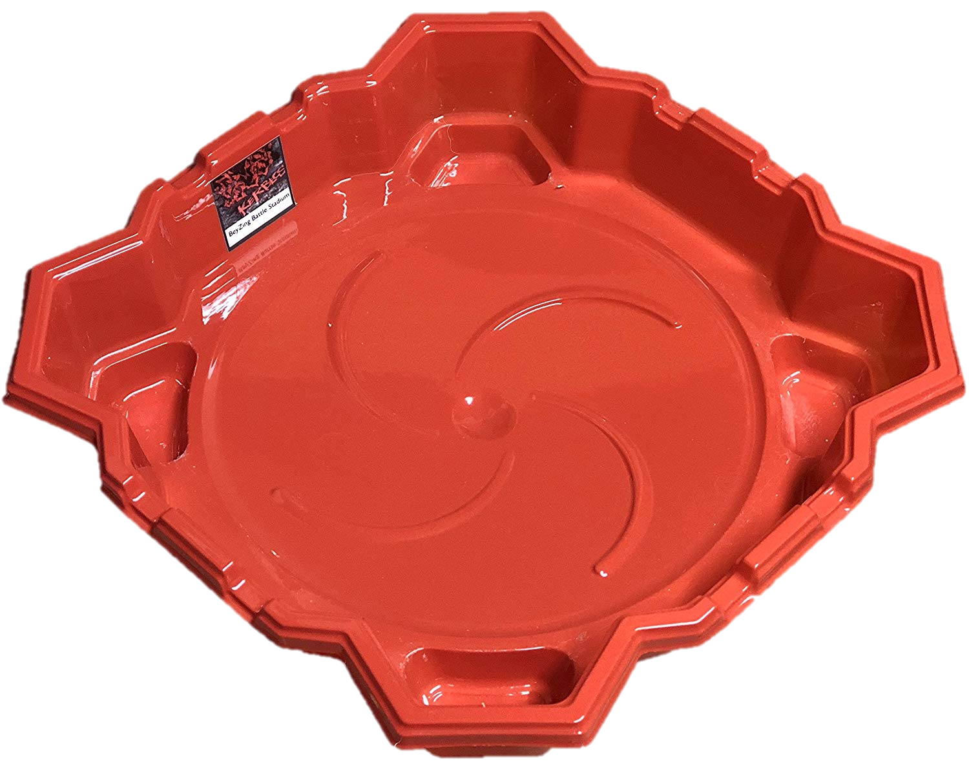
Arena CAD/CAM
Omar Elsewify
October 27th, 2020

Slide 2
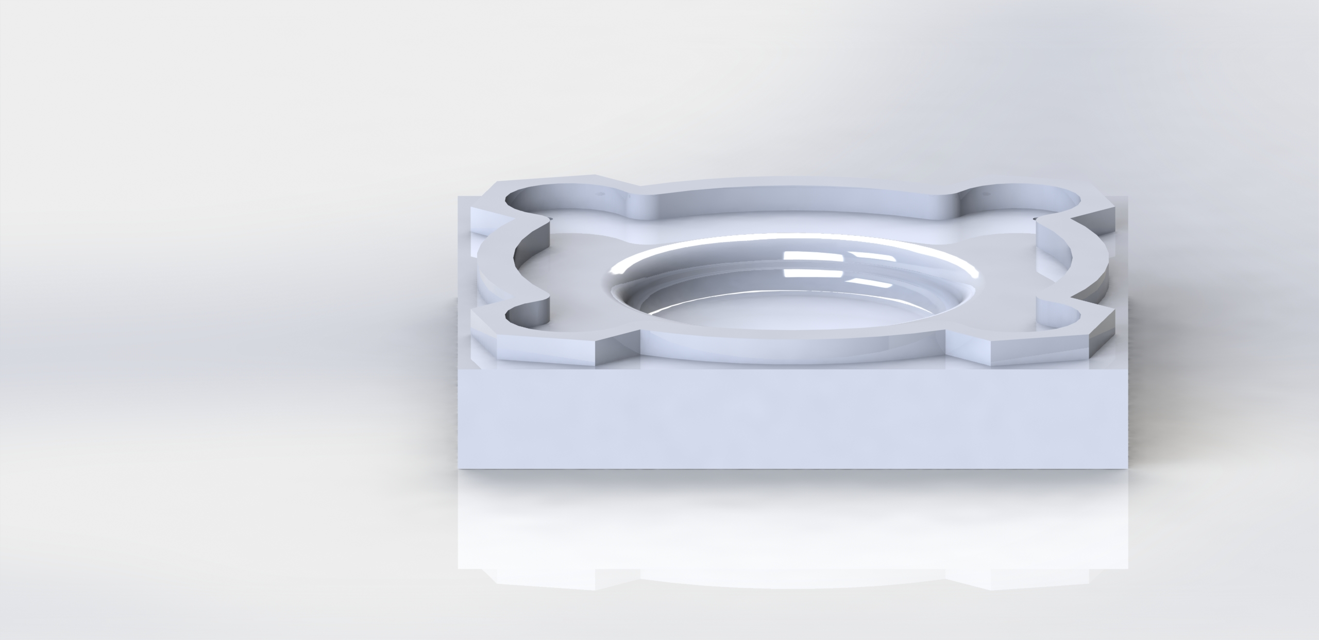
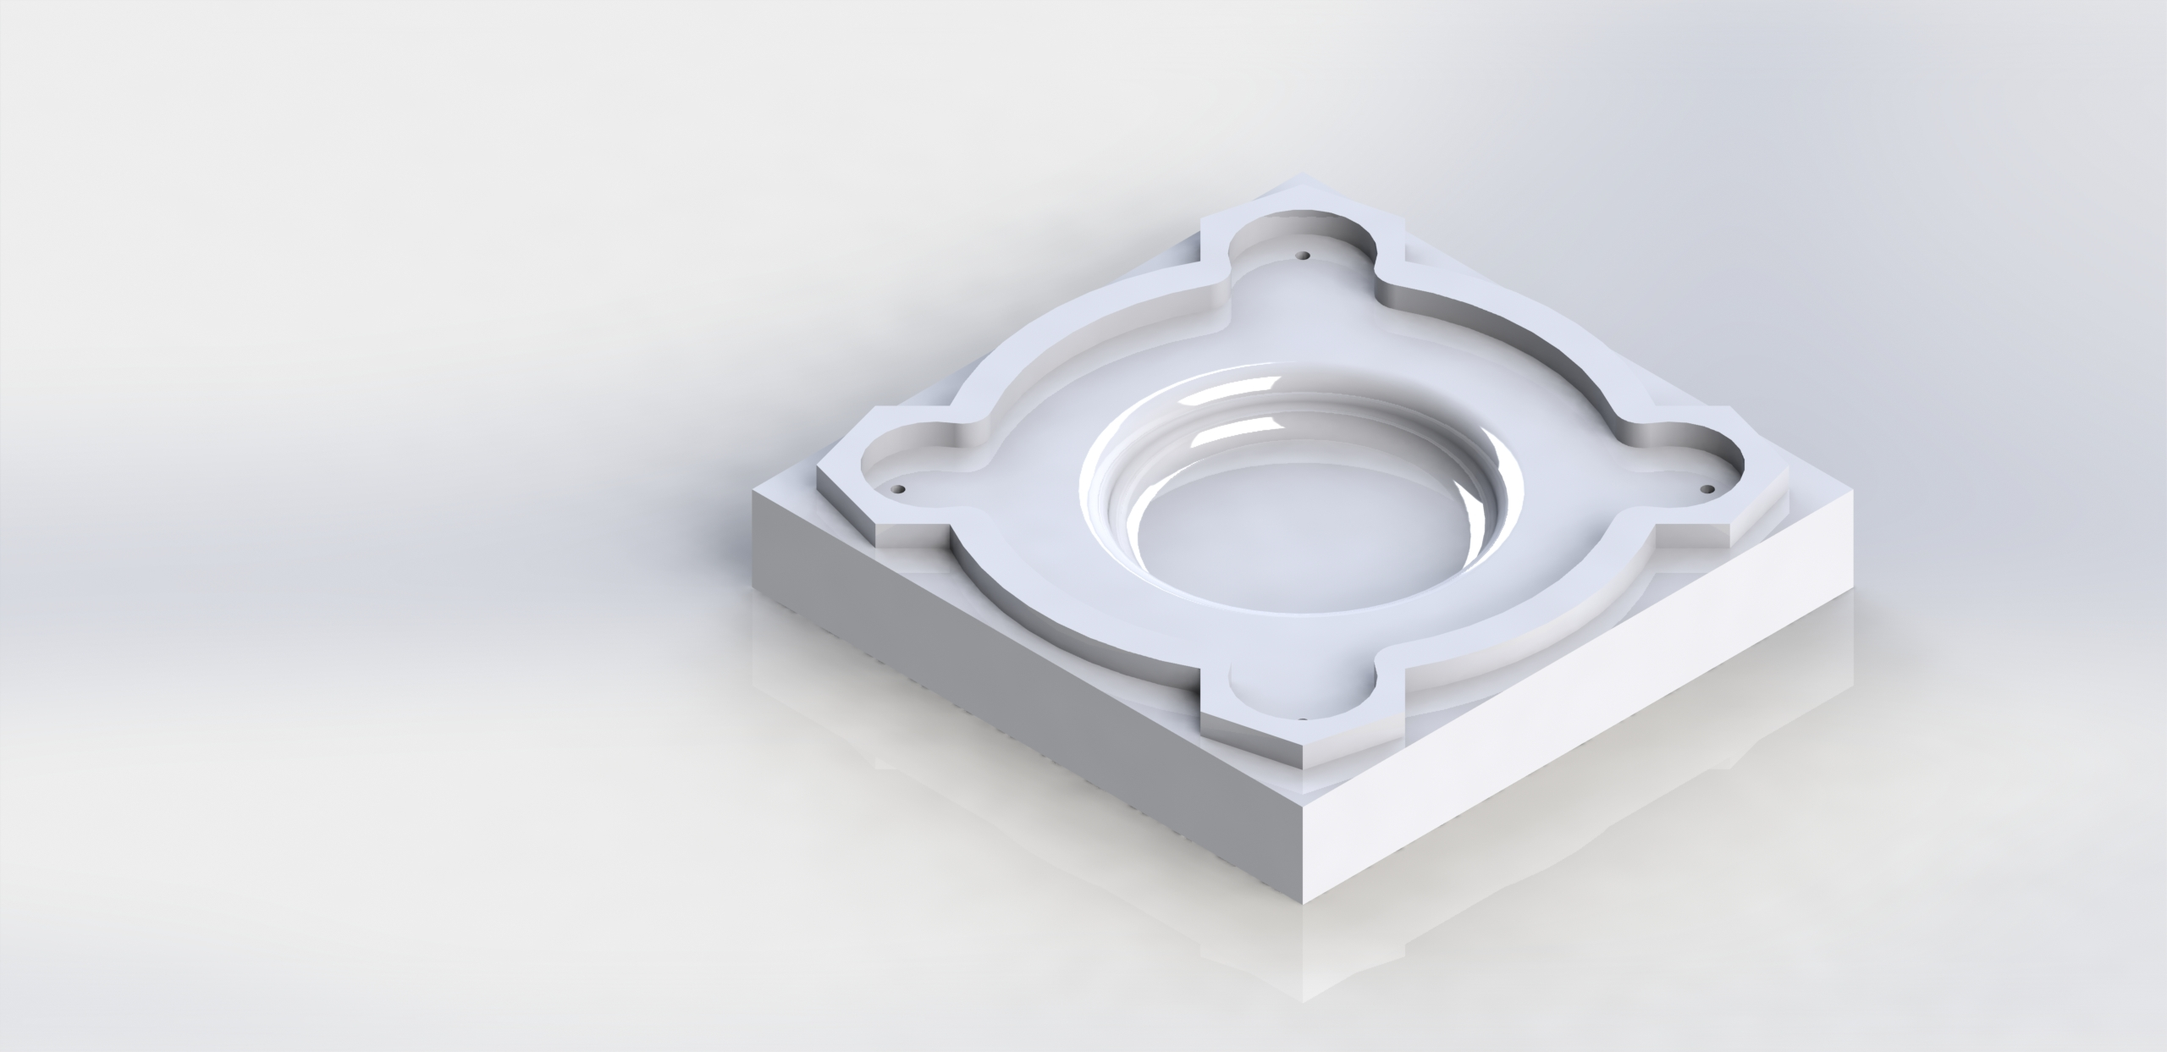
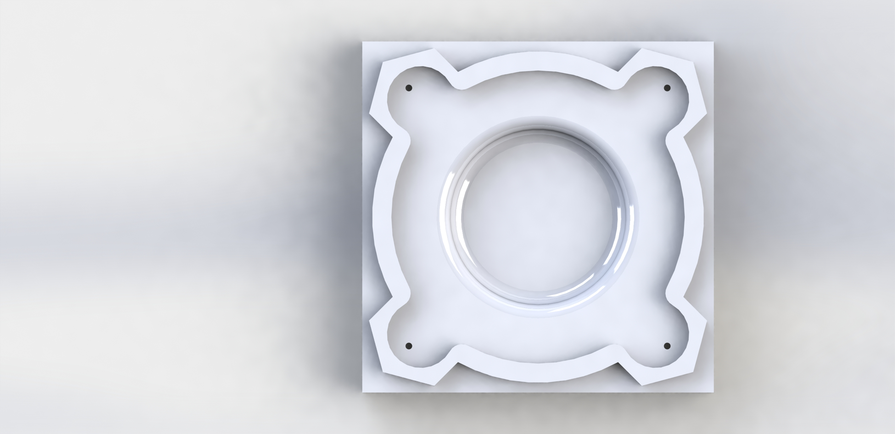
Final Design

Slide 3
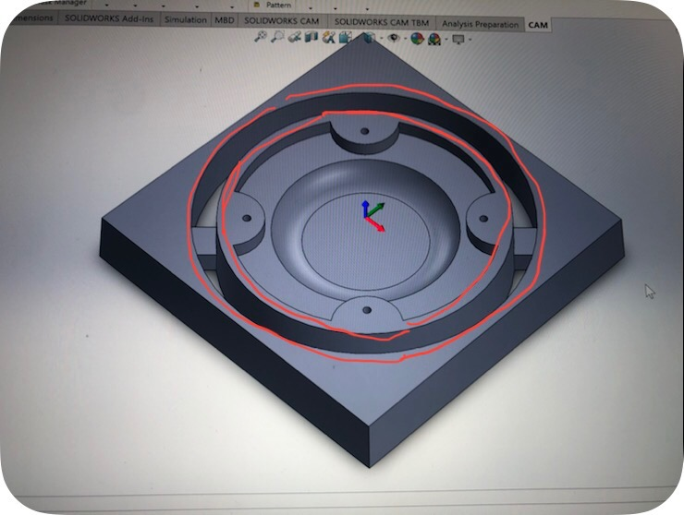
Design Decisions
Too time consuming
Tools would collide with stock
Waste of material
I also considered making a stepped cut to make sure the tool won’t collide, but it was just too time consuming

Slide 4
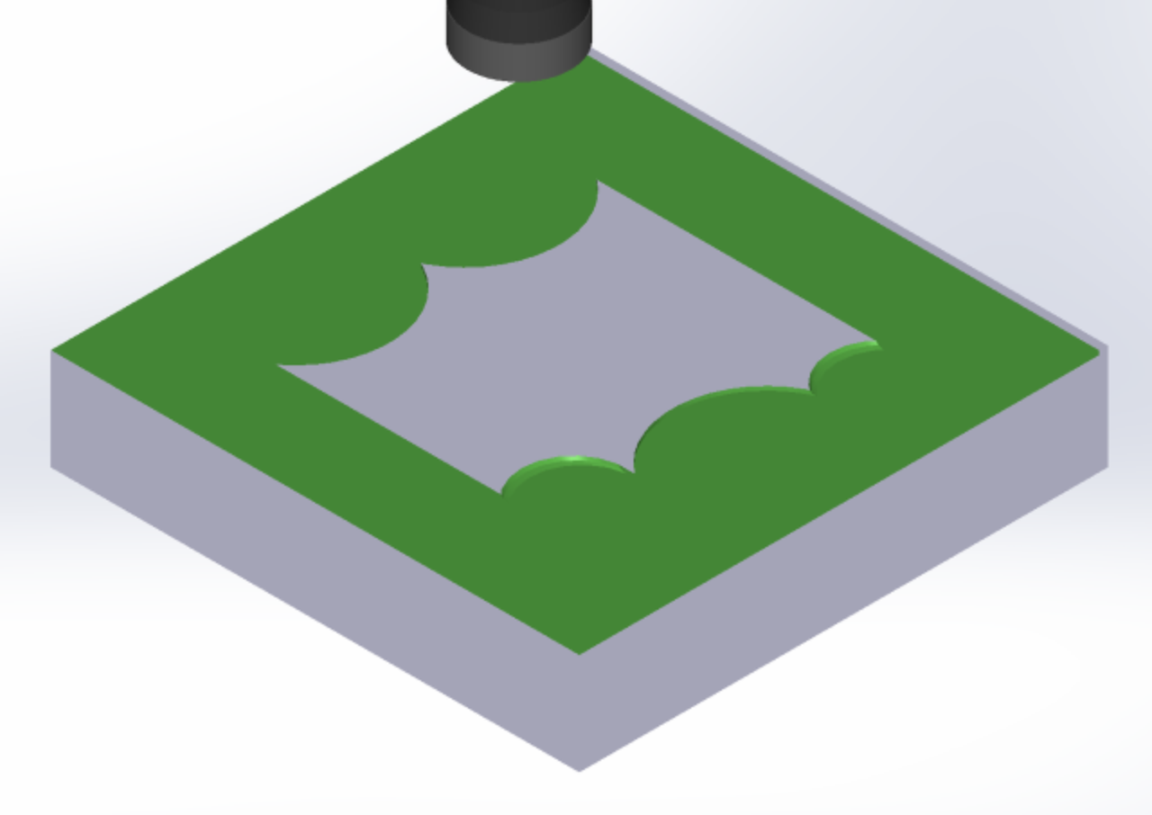
FACE operation

Slide 5
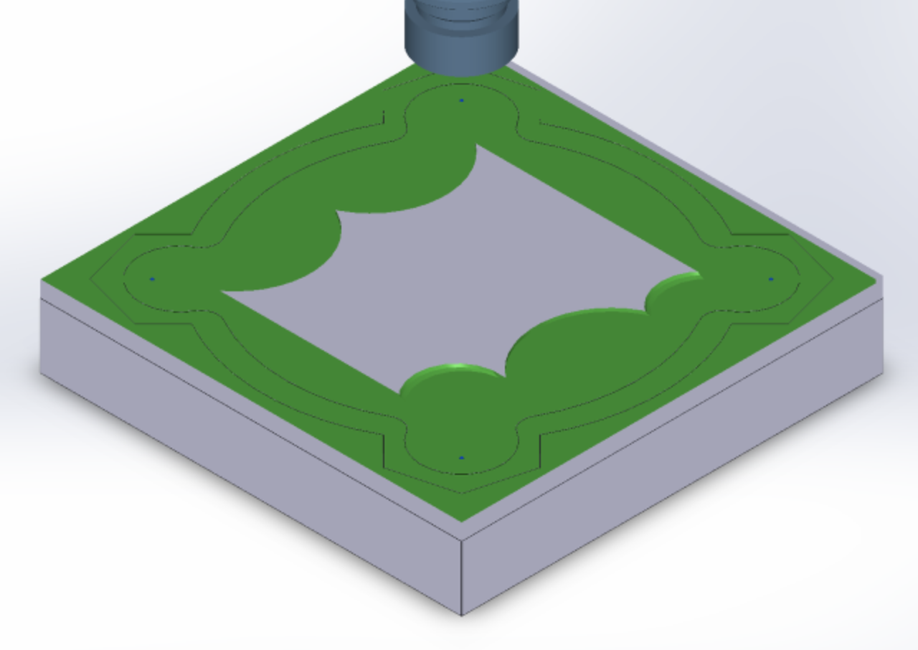
Center Drill operation

Slide 6
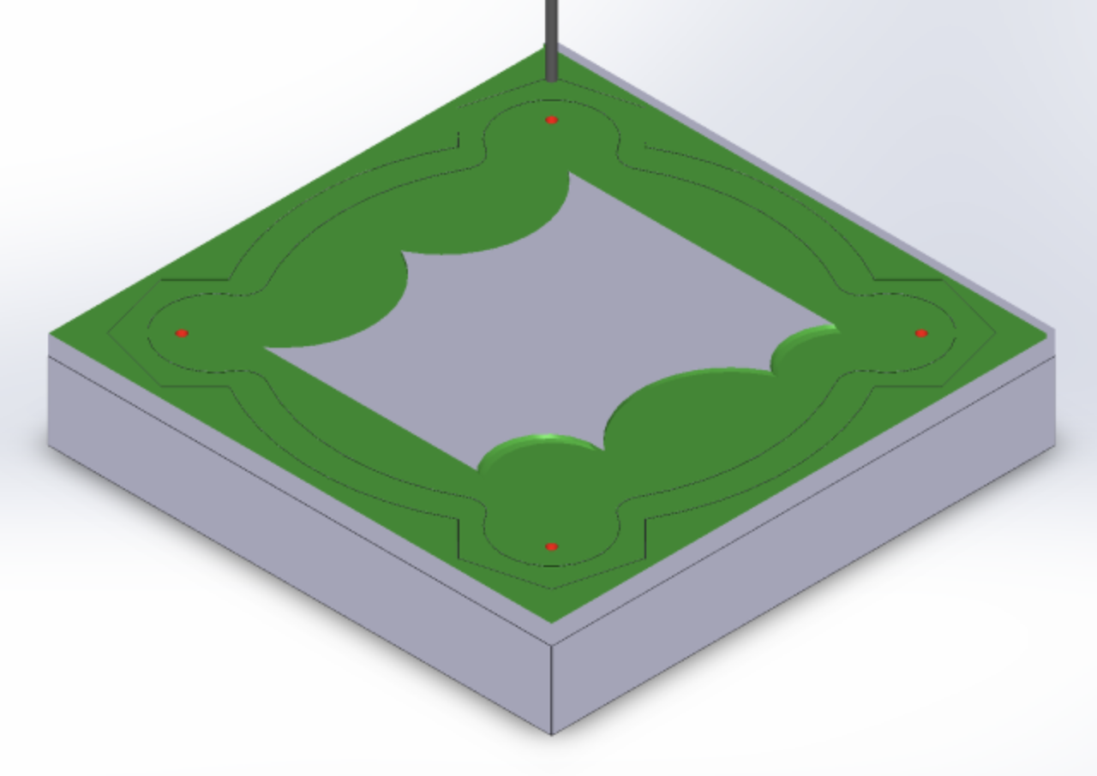
Spot Drill Operation

Slide 7
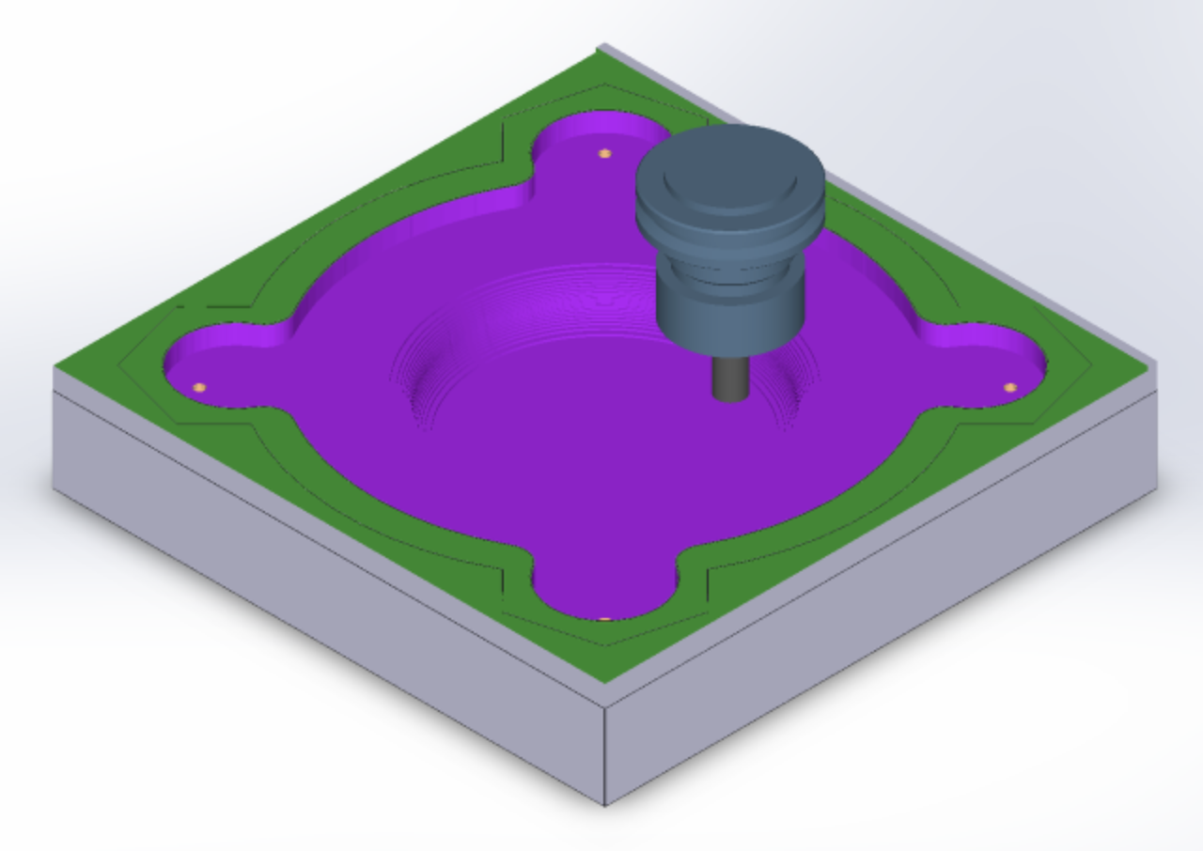
Adaptive Clearing #1 – Flat End Mill

Slide 8
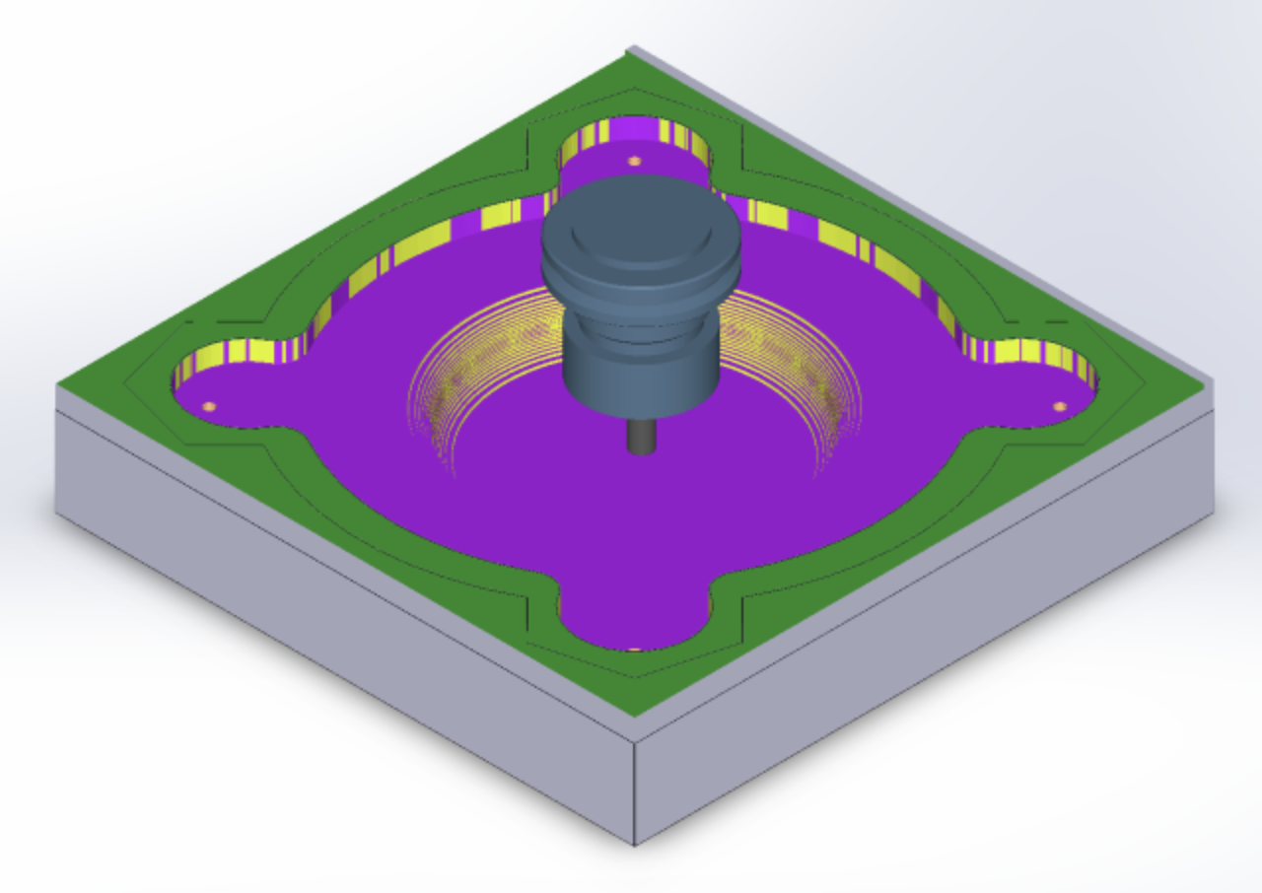
Adaptive Clearing #2 – Bullnose

Slide 9
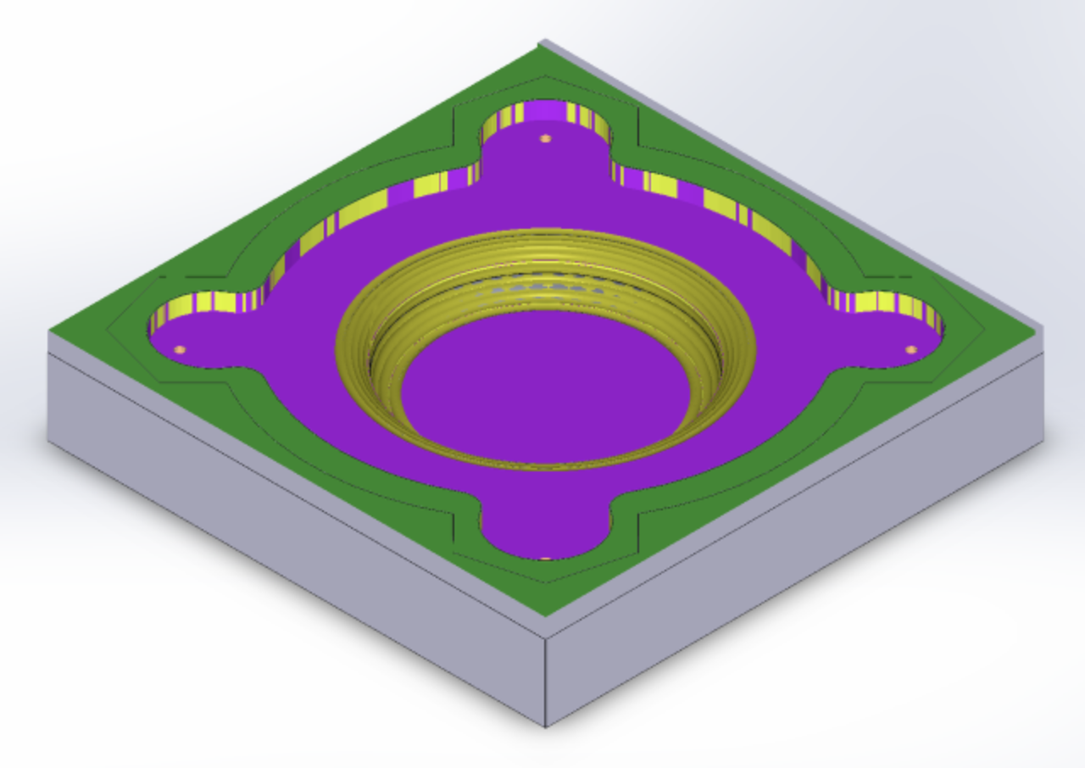
Scallop – Ball End Mill

Slide 10
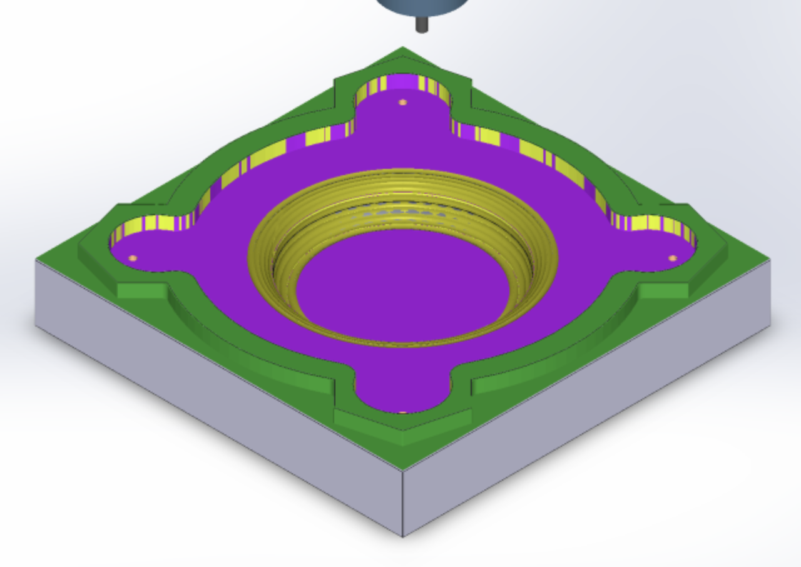
Adaptive Clearing #3 – Flat End Mill

Slide 11
SolidWorks DRAWING

Slide 12
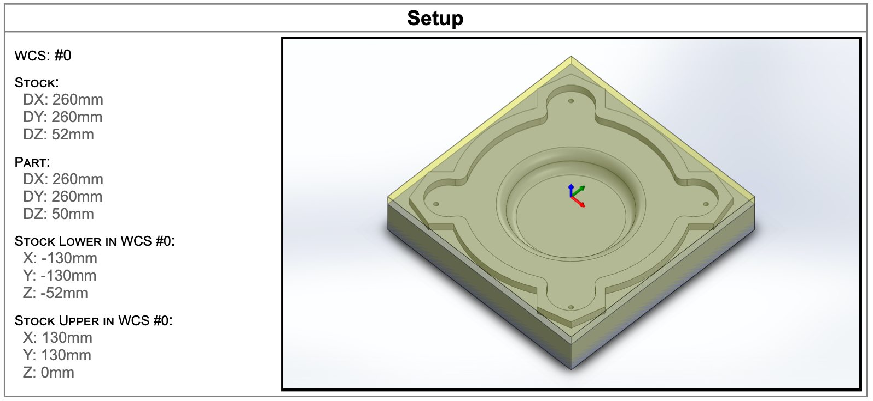
Stock Setup

Slide 13
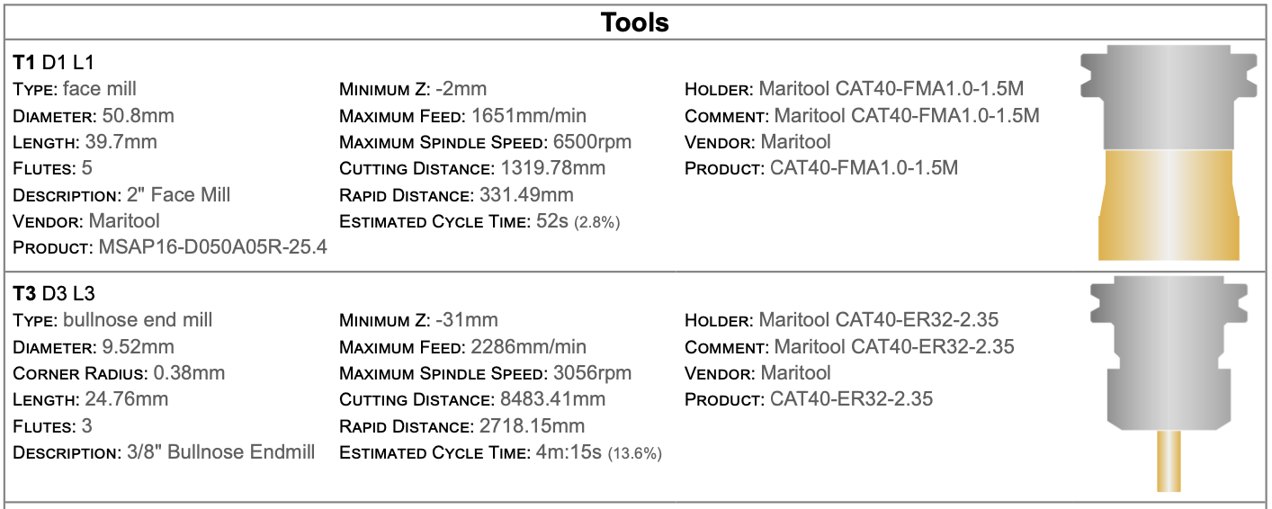
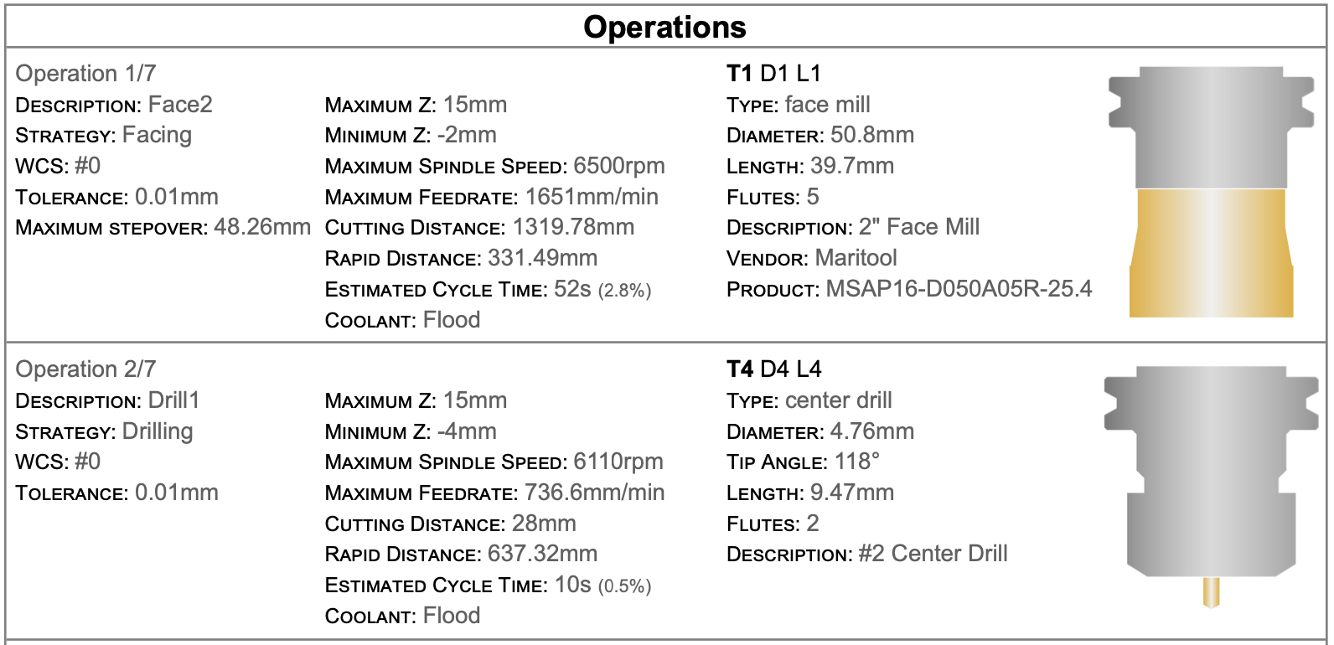
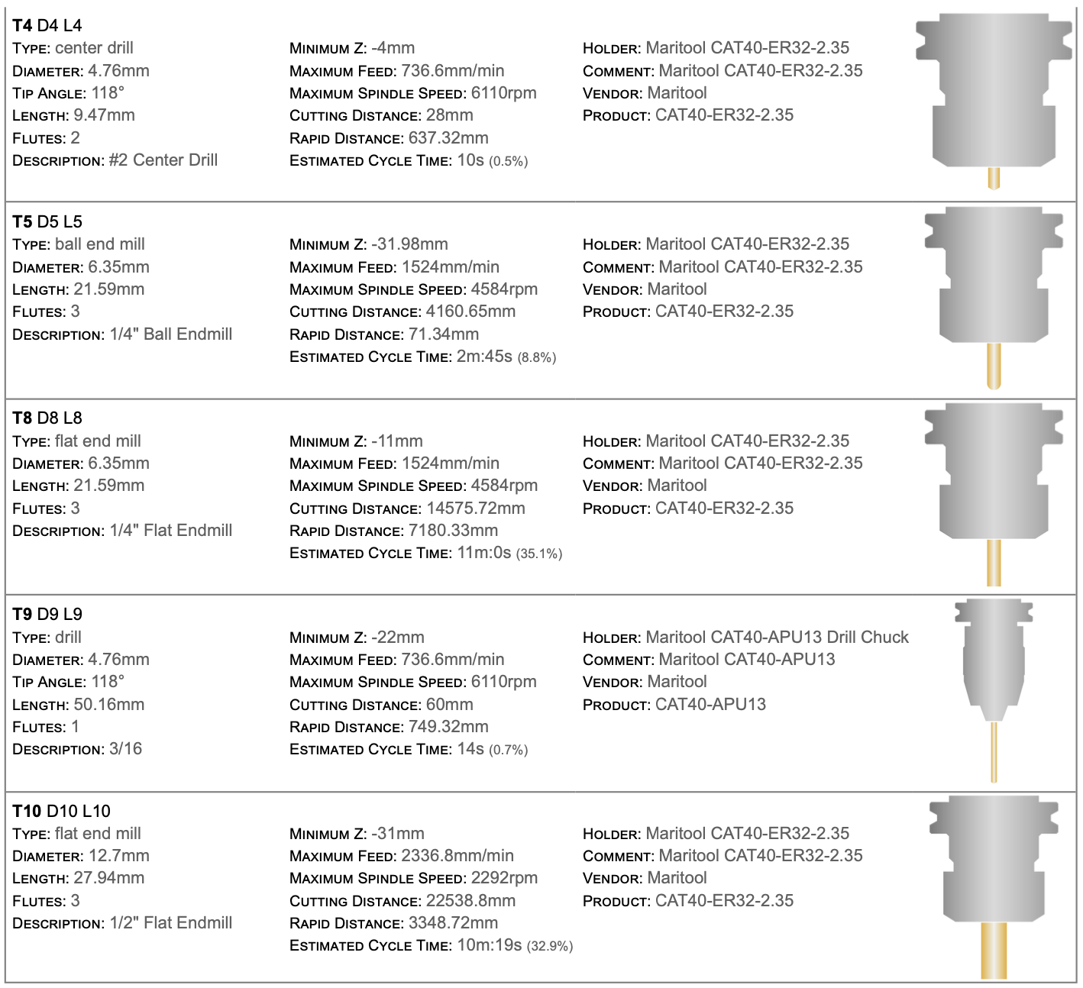
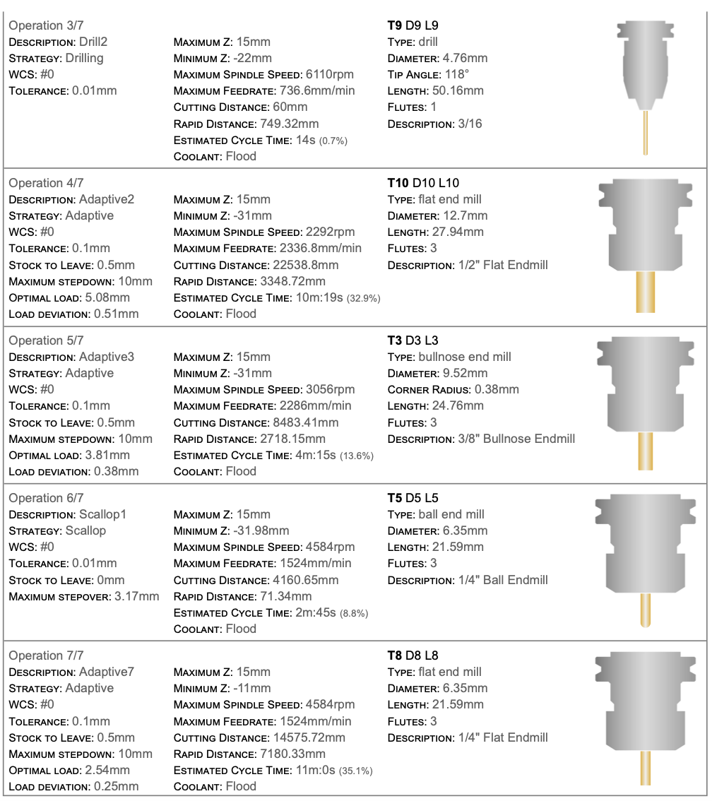
Tool List
and
Operations

Slide 14
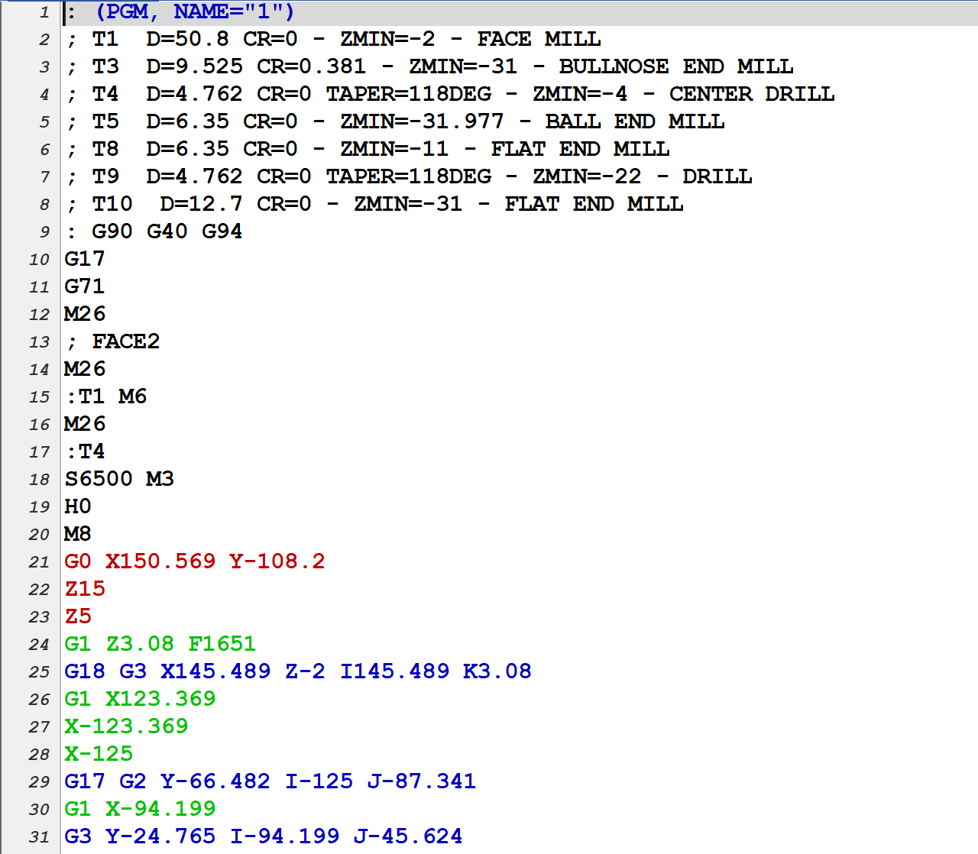
G-Code

